Slide 1

Victims – an overview

Slide 2
Who is a victim?
Anyone who has suffered physical, mental, emotional, financial or other damage as a result of a crime
More generally, who anyone who has suffered the above as a result of another’s actions

Slide 3
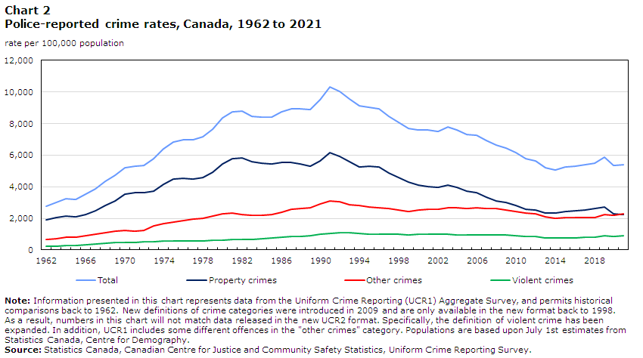
Overall crime rate

Slide 4
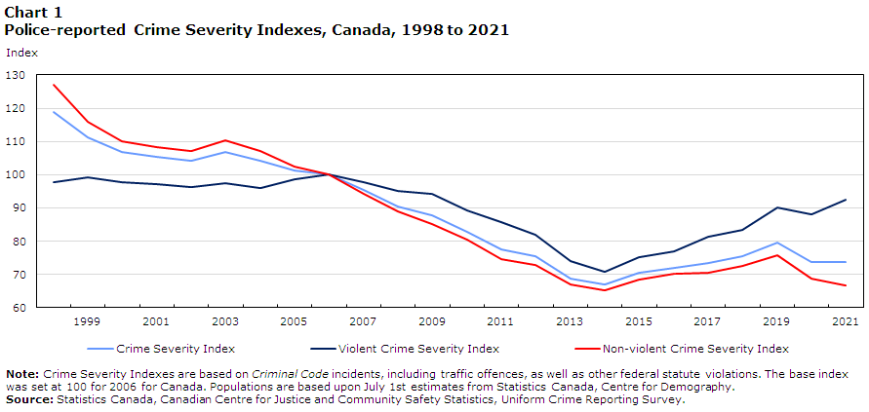
Crime severity index

Slide 5
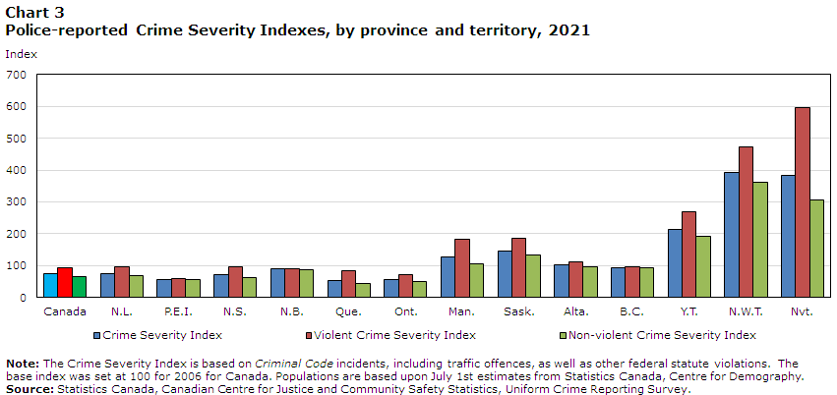

Slide 6
Reporting rates
Based on a ten year study of reporting rates (1999-2009), StatsCan (2015) found that about one third of victims report crimes to the police. Crimes with the highest levels of ‘underreporting’:
Sexual assault (where the perpetrator is not a spouse): 88% not reported
Sexual touching: 93% not reported
Sexual attacks (sex with violence): 64% not reported
Spousal violence: 88% not reported (increased from 83% not reported)

Slide 7
Factors associated with under-reported (Stats Can 2015)
Factors that increase likelihood of reporting:
Severity of crime (including presence of a weapon)
Multiple perpetrators
The emotional impact on victims
If victim’s daily activities were disrupted

Slide 8
Why don’t victims report? (Huey 2013, 2014)
Not wanting to get loved ones ‘in trouble’
Crime not important enough
Street code – ‘no snitching’
Victim not important enough/lack of trust in the system
No one would believe the victim
Learned from family to never tell
Victim blaming/self-blaming

Slide 9
Not wanting to get loved ones ‘in trouble’
R: Broken arms and several broken parts…Never went to the hospital, though…Not for any violence…I would never go…Just keep it to myself…Never got the police involved or anything like that…
I: Why is that?
R: Maybe it’s because I’ve got…I dunno…Not to a partner, or…to a family member or summit like that…I won’t get the police…I just think that they must have summit going on in their mind or stuff…They have lots to deal with and they didn’t mean it…So, you don’t want to say anything. (woman from Manchester)

Slide 10
Lack of trust in the system
A: Sometimes I go to walk my dog and my daughter was sick and I had to go with her. I come back, my stuff taken. My phone, my pills, my panties. My pennies. I would give them if they needed it.
Q: Did you tell anyone?
A: I told [name deleted]. They say they cannot do anything.
Q: What about the police?
A: No. The police over here is crooked. They only serve and protect the people who got the money. They don't come. You could be dead and they won't come (woman in Chicago).

Slide 11
Fear of retaliation
I: You were victimized by someone who wasn’t your partner…
R: It was my partner’s family…It was intentional…They came looking for me…My hair…This is why I have to wear my hair like this – it’s full of bald spots…
I: When that happened, did you go to the hospital? The police?
R: I went to the hospital and reported it to the police…I always got scared because they told me that if I ever reported it, they would come and kill me…I believed it…That’s why my mom has got the kids, as (Liverpool woman).

Slide 12
No one would believe the victim
Domestic violence victim in Detroit:
No. No one would have believed me. I realized it was bad when the police were being called, and nothing would happen…No one would believe me because…looking at us, we were the perfect couple. We had the perfect family, on the outside…I’m at home, I don’t work, my husband makes a very good living. Our kids are cute and dressed nice. They go to very expensive schools … They would have never believed me.

Slide 13
Learned from family to never tell
Victim of childhood sexual abuse:
A: I came and told my Auntie what happened, but she brushed it off.
Q: So what you learned is that there's no point in ...
A: saying anything. She always told us when we was coming up that if someone did do something to us we could come to her and talk to her. Now when I finally tell you something happened, you push me to the side or tell me other things. Like as if you didn't believe me.
Q: So we learn that there's nothing we can do.
A: Just keep it in and try to deal with it.

Slide 14
Victim blaming/self-blaming
Victim of sexual assault (Detroit):
A: Me and my friends used to drink gallons a day. And I never, ever had that happen to me or ... that I'd be passed out like that. If I passed out, I was at home. In a good setting. But never did that happen. We still have problems from that. My son's going to be 3 years old. And we still have problems ... because we just came into the treatment, to the system about 8 months ago. He hasn't ... he don't talk about it. The only time he talks about it is when he's angry. And those are not nice things that he says.
Q: Is there an element of blaming you?
A: Yeah. He blames me because he says I shouldn't have been there. I'm like, 'when you was drinking, you'd party with my friends.'

Slide 15
Self-blaming
R: One time, I was…I had drank a lot…I remember somebody pulling my pants down and they were on top of me…I was so out of it, it was crazy…When I woke up, my pants were on backwards and my underwear were inside out…I knew then…My chain had been stolen and I knew something had happened…
I: Did you go to the doctor?
R: No. I just went home and took a shower…I think I cried…
I: Were you just numb at that point?
R: I think to be honest, and it sounds crazy, but that was the last thing that came to my mind…What came to my mind was that it was my fault, and I shouldn’t have drank like that…I mean, I was chugging ‘em back, girl…It was vodka…Ya, I mixed it, but I mixed it lightly…Because it wasn’t strong, I was tossing them back…I was like, you have no one to blame but yourself because you put yourself in that situation… (Chicago sexual assault victim).

Slide 16
Victims and the CJS experience
https://www.youtube.com/watch?v=BOrwmgd_l5g

Slide 17

*all done!*

